Slide 1

HR ANALYTICS & EMPLOYEE INSIGHTS
A data-driven overview of employee performance, satisfaction, and retention.
1

Slide 2
Team Members
Muhammed Imran
1
Sherif Elmahdy
2
Supervisor:
Ahmed Ayman Elsaey
Ahmed Elseify
3
Fatma Salah
Group Name:
ITC_GHR3_DAT1_G1
4
Heba Elhosseiny
5
2

Slide 3
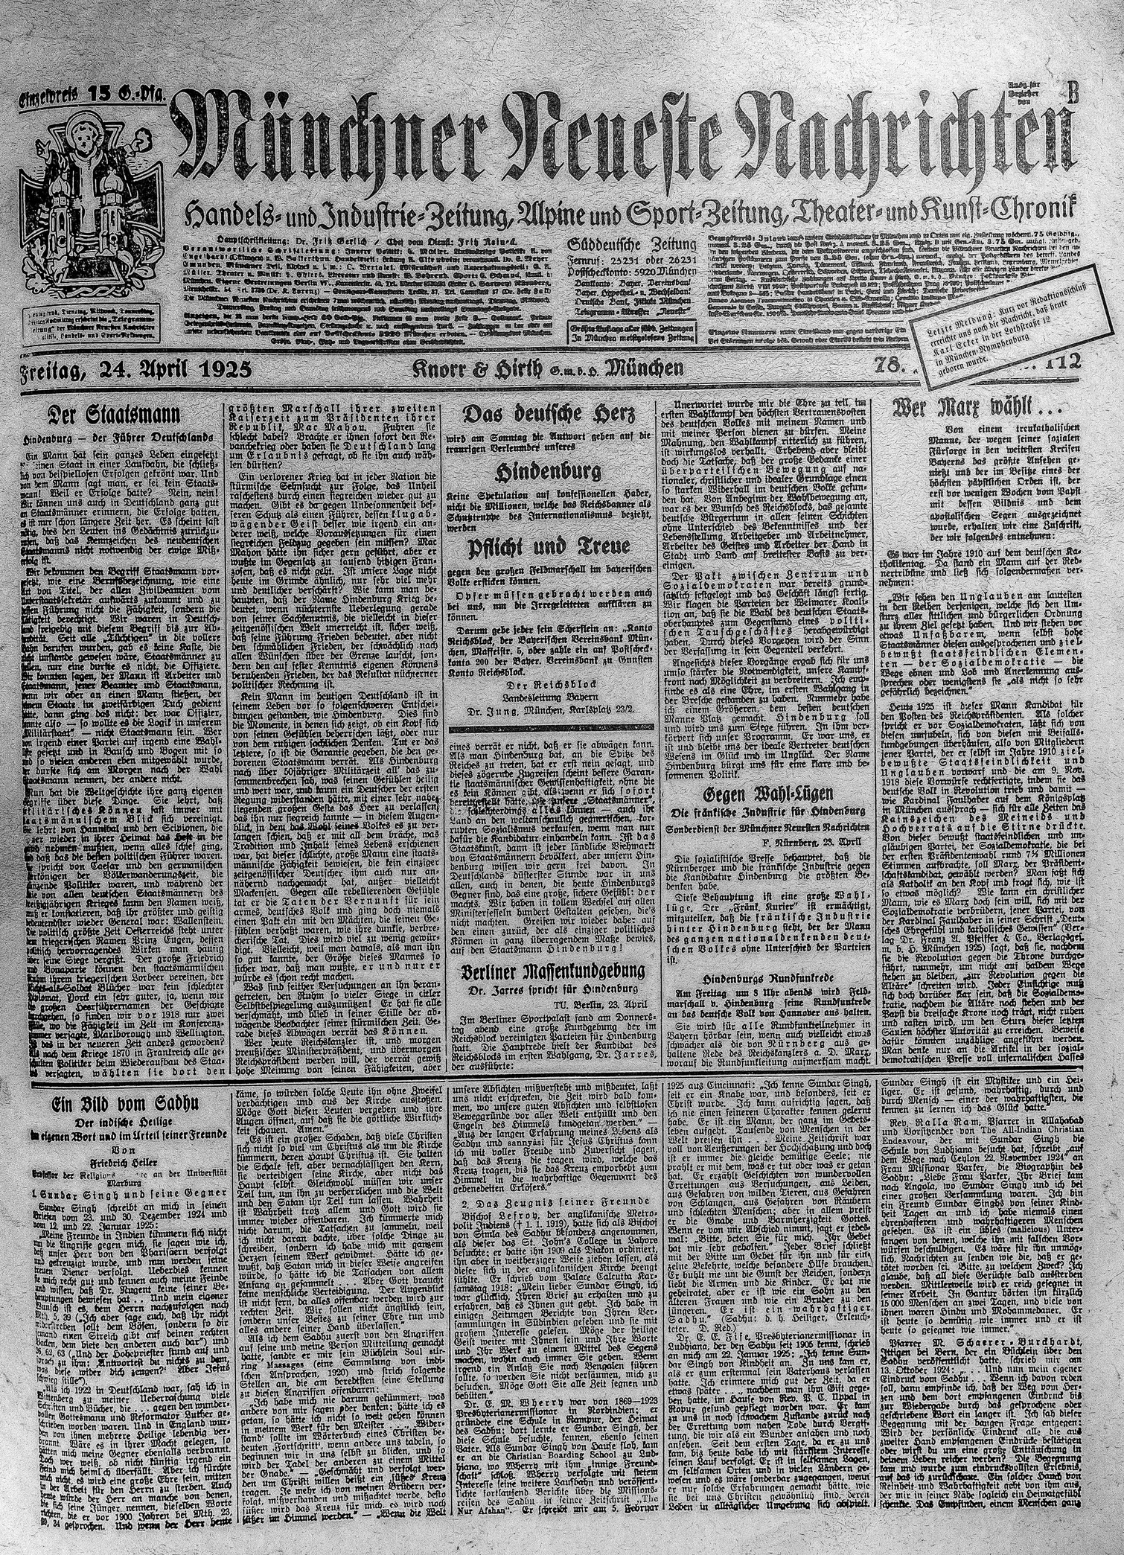
WHY WE ARE HERE TODAY
• Every organization has one silent challenge that shapes its success: keeping its people. Over the last few years, companies have been losing talented employees faster than ever—often without warning.
• Our project began with a simple question: “Can we predict when an employee is likely to leave, before they actually do?”
• And this is where our journey started.
• Company Status: We learned that despite a solid 84% retention rate, hidden patterns were quietly pushing employees out.
• We chose this project not only to solve a problem ,but because we aim to build a company specialized in employee performance evaluation—a company that uses data to help organizations understand their people before they lose them.
3

Slide 4
Agenda
Project Overview & Objective
Key Features &Technologies Used
Business challenge
Recommendations
4

Slide 5

BUSINESS CHALLENGE
Total Attrition 16%
(2012 -2022)
21%
The Sales Team – The Struggle Behind the Numbers
As we explored the data, certain groups began to stand out—almost like characters in a story where each one had a reason to leave.
40%
Sales Representatives – The Highest Risk Group
25%
Frequent Travelers – The Burnout Group
21%
Young Employees (20–29) – The Early Exiters
The company wasn’t losing employees randomly. It was losing them for predictable reasons.
5

Slide 6
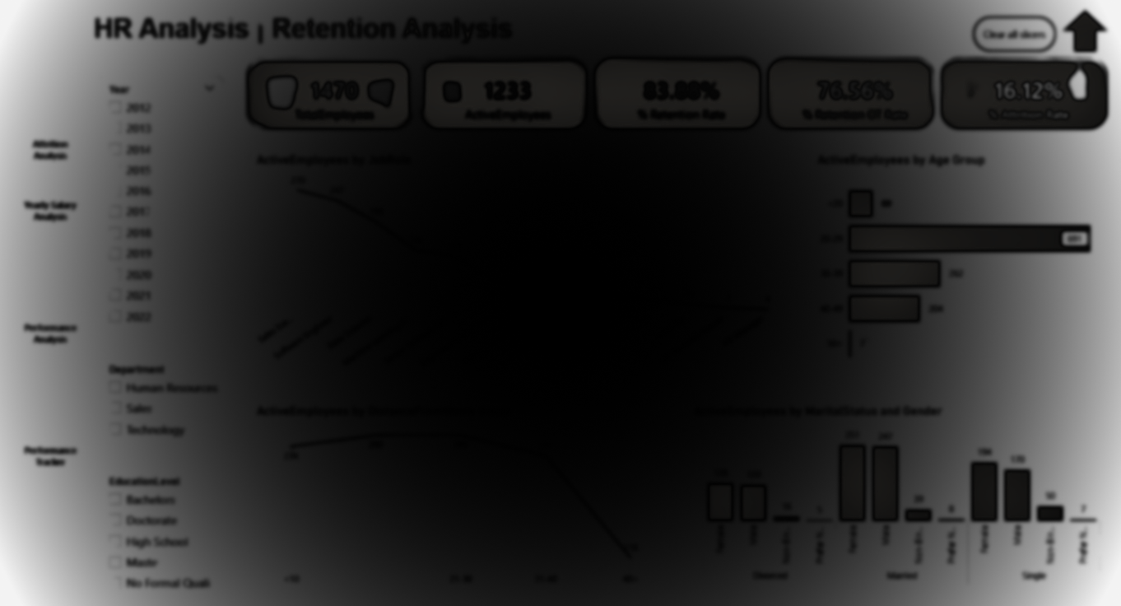
PROJECT OVERVIEW
Workforce Insights
Our project provides HR teams with insights into employee satisfaction, performance trends, and retention risks. It helps identify areas for improvement, predict turnover, and make data-driven decisions to enhance overall workforce experience.
6

Slide 7
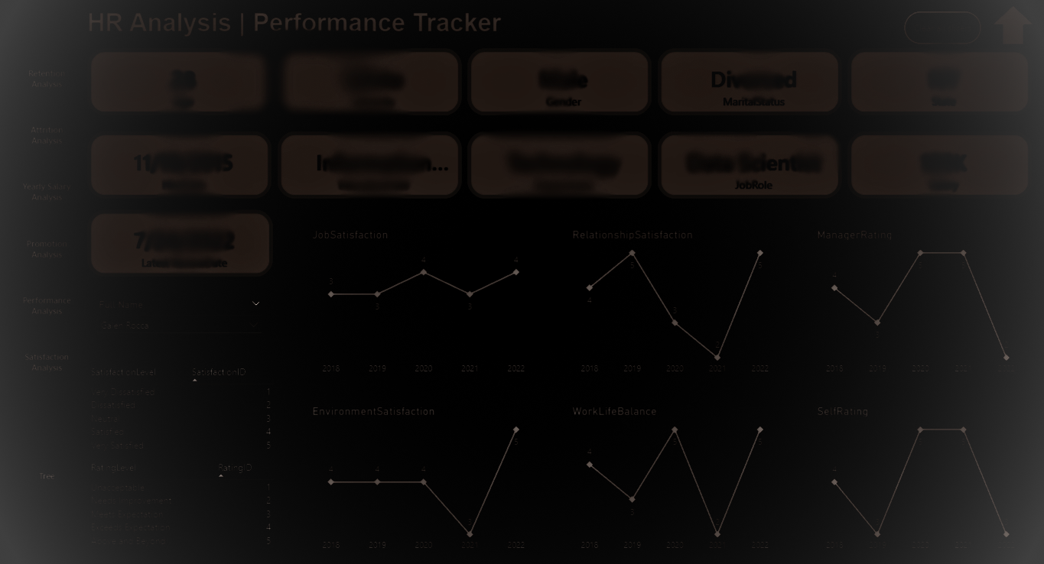
TECHNOLOGIES USED
Core Tools
Python –Cleaning & Preprocessing
– Modeling and predictions (AI Model)
SQL – Modeling & Querying structured data
Power BI – Interactive visual dashboards
7

Slide 8
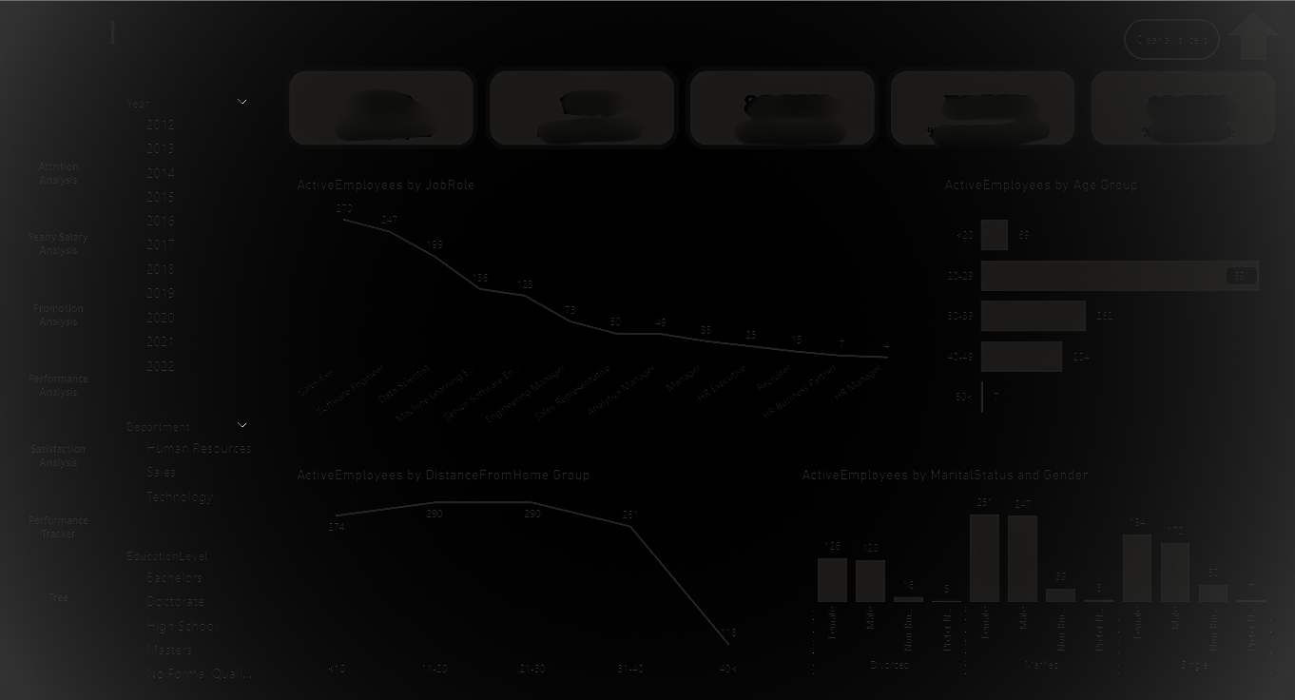
Key Features (8 Dashboards & AI Model)
01
Retention Analysis
02
Attrition Analysis
03
Yearly
Salary Analysis
04
Promotion Analysis
08
Tree
06
Satisfaction Analysis
07
Performance Tracker
05
Performance Analysis
09
AI Model
8

Slide 9
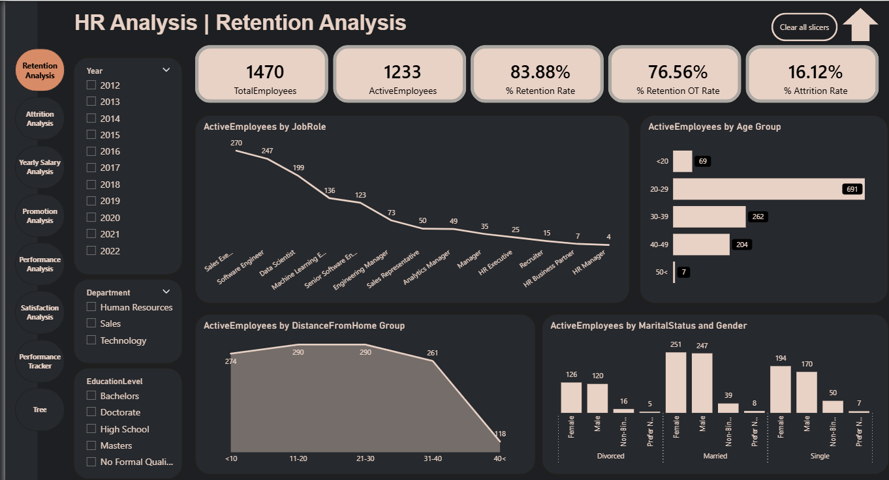
DASHBOARDS
Dashboards showcase practical examples from the HR analytics project, including insights and prediction outputs that support data-driven decision making.
Check Dashboard
9

Slide 10
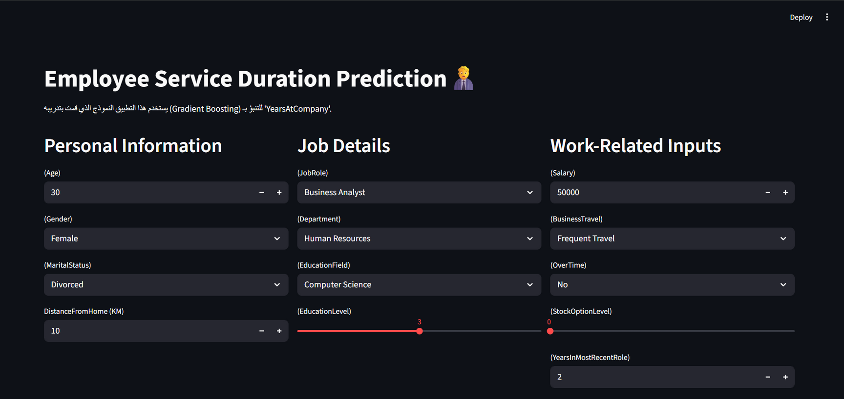
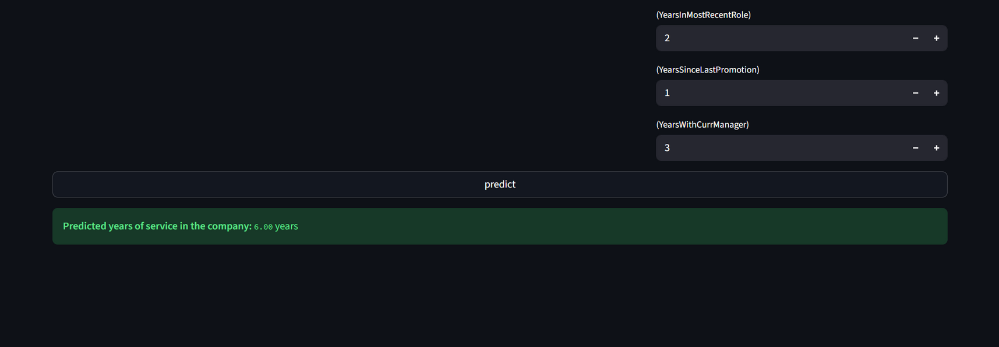
AI MODEL
AI component is to predict the number of years an employee is expected to stay in the company based on historical employee data.
Run Model
10

Slide 11
01
Review the salary and commission structure for sales representatives immediately, as their current salary is not keeping them.
RECOMMENDATIONS
02
Strengthen actions using data
Limiting employees to a certain percentage of travel per month or implementing a job rotation policy to reduce the travel burden on the same people or offering extra vacation days or higher allowances to frequent travelers.
05
03
It is recommended that the company adopt the 360-degree evaluation method, as it is the most suitable approach for the current situation of the company.
Establish a mentorship program for new and young employees to connect them with experienced staff and increase their engagement with the company, as they tend to leave quickly or review flexible working and remote work policies.
06
04
Implement periodic monitoring of the AI tenure-prediction model to highlight employees with low predicted tenure and enable timely HR interventions.
The company should regularly conduct exit interviews to analyze the real reasons behind employee departures, which will help in developing effective strategies for talent retention and improving the work environment.
11

Slide 12

Conclusion
1
2
3
the company has good overall stability (Retention 84%), but there are weaknesses in the sales department and among younger, more frequent travelers.
Focusing on reforming sales compensation and travel policies .
Having an AI model helps HR in decision making processes
12

Slide 13
THANK YOU FOR YOUR ATTENTION
13

